Slide 1

Introductory Statistics
Introductory Statistics

Slide 2
Inference for Two Means: Independent Samples
Intro to Independent Samples
Hypothesis Testing
Confidence Intervals
Checking Requirements

Slide 3
Dependent vs Independent Samples
Dependent Samples – Individuals in one sample are used to determine the units or individuals to be in the second sample
e.g., are sons taller than dads?
Independent Samples – Individuals in one sample do not dictate which units or individuals are to be in the second sample.
e.g., who scores better in stats test, males or females?

Slide 4
Inference for Two Means: Independent Samples
Intro to Independent Samples
Hypothesis Testing
Confidence Intervals
Checking Requirements

Slide 5

Steps to Hypothesis Testing – σ known
State the null and alternative hypotheses
Determine the level of significance (α) – mostly given to you in this class
Compute the Test Statistic:
Determine P-Value based on Test Statistic. (Use Applet)
Reject the Null Hypothesis if the P-value is less than the level of significance (α), if not then don’t reject.
State the conclusion (in layman’s terms)
If Reject H_{o} – We have sufficient evidence to say that “state H_{a} in English”
If Don’t Reject H_{o} - We have insufficient evidence to say that “state H_{a} in English”

Slide 6

Steps to Hypothesis Testing – σ unknown
State the null and alternative hypothesis
Determine the level of significance (α) – mostly given to you in this class
Do Steps 2-4 with Software
Compute the Test Statistic:
Determine the Degrees of Freedom
Determine P-Value.
Reject the Null Hypothesis if the P-value is less than the level of significance (α), if not then don’t reject.
State the conclusion
If Reject H_{o} – We have sufficient evidence to say that “state H_{a} in English”
If Don’t Reject H_{o} - We have insufficient evidence to say that “state H_{a} in English”

Slide 7
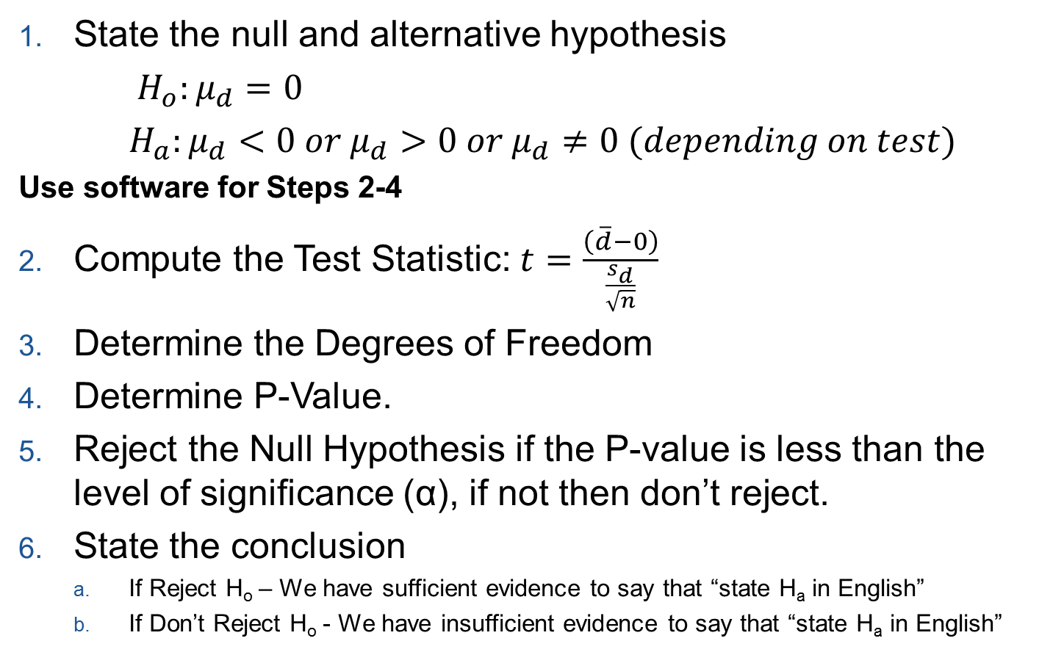
Steps to Hypothesis Testing – Matched Pairs
State the null and alternative hypothesis
$H_{o}:μ_{d}=0$
$H_{a}:μ_{d}<0 or μ_{d}>0 or μ_{d}≠0 (depending on test)$
Use software for Steps 2-4
Compute the Test Statistic: $t=\frac{\left(\overline{d}−0\right)}{\frac{s_{d}}{\sqrt{n}}}$
Determine the Degrees of Freedom
Determine P-Value.
Reject the Null Hypothesis if the P-value is less than the level of significance (α), if not then don’t reject.
State the conclusion
If Reject H_{o} – We have sufficient evidence to say that “state H_{a} in English”
If Don’t Reject H_{o} - We have insufficient evidence to say that “state H_{a} in English”

Slide 8

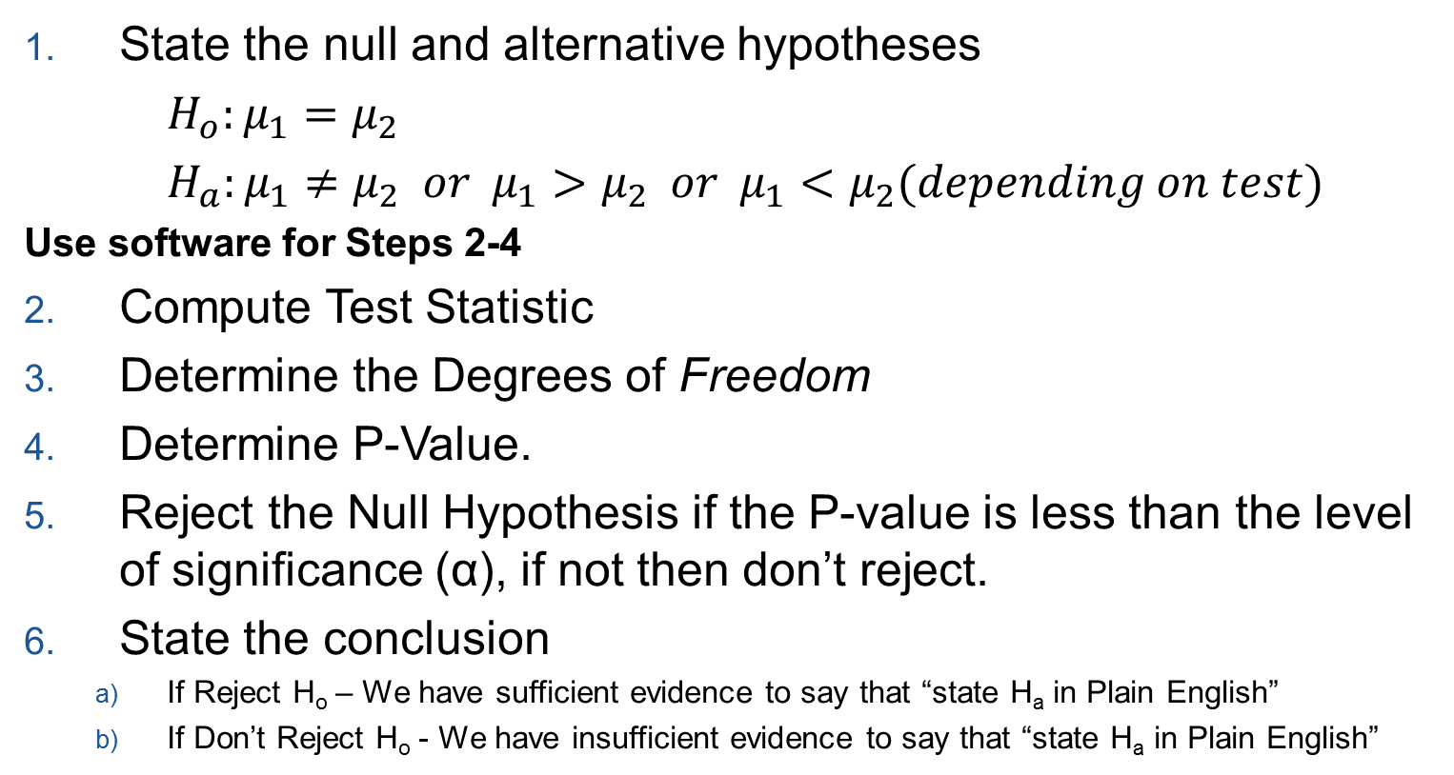
Steps to Hypothesis Testing – Independent Samples
State the null and alternative hypotheses
$H_{o}:μ_{1}=μ_{2}$
$H_{a}:μ_{1}≠μ_{2} or μ_{1}>μ_{2} or μ_{1}<μ_{2}(depending on test)$
Use software for Steps 2-4
Compute Test Statistic
Determine the Degrees of Freedom
Determine P-Value.
Reject the Null Hypothesis if the P-value is less than the level of significance (α), if not then don’t reject.
State the conclusion
If Reject H_{o} – We have sufficient evidence to say that “state H_{a} in Plain English”
If Don’t Reject H_{o} - We have insufficient evidence to say that “state H_{a} in Plain English”

Slide 9
Hypothesis Testing – Independent Samples (Example)
Researchers led by Arlene Butz published a study on the reading practices of children . They wanted to know if there was a difference in the reading practices of children with developmental or behavioral problems (the DEV group or Group 1) compared to children in the general population who do not have developmental problems (the GEN group or Group 2.) One of the factors they considered was the number of nights each week that the children participated in reading in the home. Data representative of their results are given in the file ReadingPractices. They used the level of significance of α = 0.05.
H_{o} : µ₁ = µ₂ H_{a}: µ₁ ≠ µ₂
t = 1.455
df = 228.427
P-value = 0.147
P-value > level of significance (α), therefore we don’t reject H_{o}
We have insufficient evidence to say that the there was a difference in the mean number of nights each week that children participated in reading in the home between the two groups.

Slide 10
Hypothesis Testing – Independent Samples (Example)
The FIFA Football (Soccer) World Cup is held every four years and is one of the biggest sporting events in the world. In 2006, Germany hosted the World Cup. A study was conducted by Dr. Wilbert-Lampen, et. al. to determine if the stress of viewing a soccer match would increase the risk of a heart attack or another cardiovascular event. We will use the data on cardiovascular problems during the World Cup to test the hypothesis that the mean number of cardiovascular events is greater during the World Cup than during the control period. Let Group 1 be days in the Control Period and let Group 2 represent days during the 2006 World Cup. Use the level of significance of α = 0.01.
H_{o} : µ₁ = µ₂ H_{a}: µ₁ < µ₂
t = -4.617
df = 106.429
P-value = close to zero
P-value < level of significance (α), therefore we reject H_{o}
We have sufficient evidence to say that the there were fewer heart attacks outside of the World Cup competition time frame than during the World Cup competition.

Slide 11
Inference for Two Means: Independent Samples
Intro to Independent Samples
Hypothesis Testing
Confidence Intervals
Checking Requirements

Slide 12
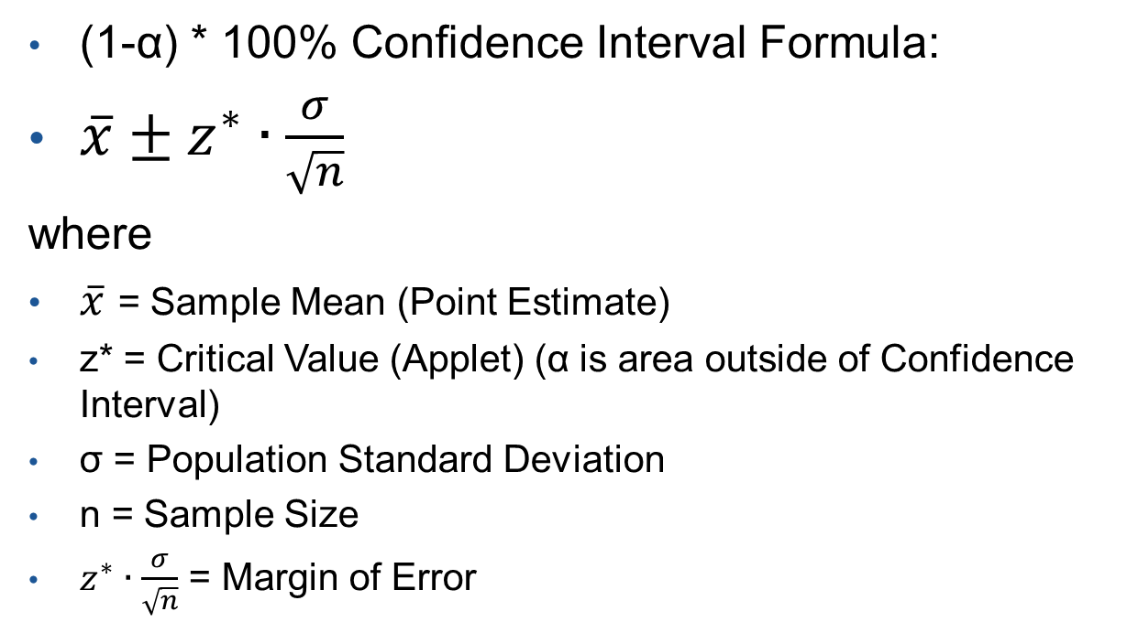
Confidence Interval (σ known)
(1-α) * 100% Confidence Interval Formula:
$\overline{x}±z^{∗}∙\frac{σ}{\sqrt{n}}$
where
$\overline{x}$ = Sample Mean (Point Estimate)
z* = Critical Value (Applet) (α is area outside of Confidence Interval)
σ = Population Standard Deviation
n = Sample Size
$z^{∗}∙\frac{σ}{\sqrt{n}}$ = Margin of Error
How realistic is the σ being known?

Slide 13
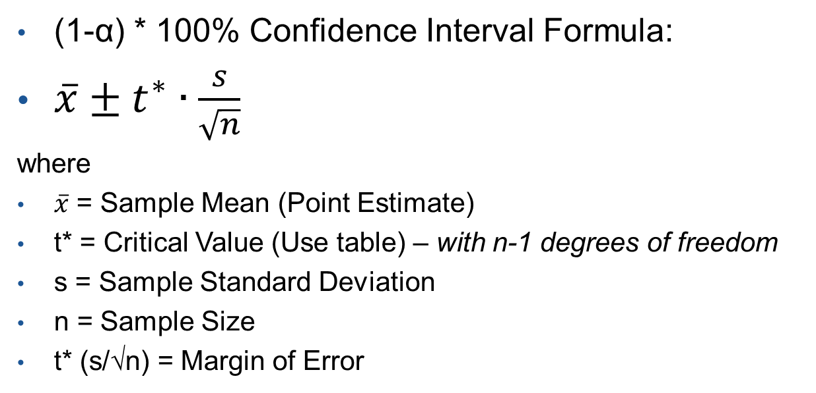
Confidence Interval (σ unknown)
(1-α) * 100% Confidence Interval Formula:
$\overline{x}±t^{∗}∙\frac{s}{\sqrt{n}}$
where
$\overline{x}$ = Sample Mean (Point Estimate)
t* = Critical Value (Use table) – with n-1 degrees of freedom
s = Sample Standard Deviation
n = Sample Size
t* (s/√n) = Margin of Error

Slide 14
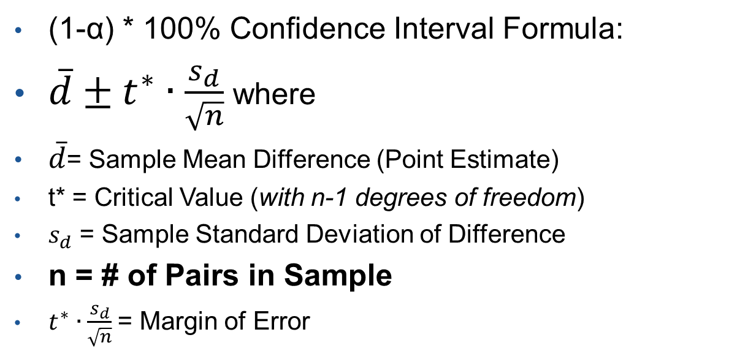
Confidence Interval (Matched Pairs)
(1-α) * 100% Confidence Interval Formula:
$\overline{d}±t^{∗}∙\frac{s_{d}}{\sqrt{n}}$where
$\overline{d}$= Sample Mean Difference (Point Estimate)
t* = Critical Value (with n-1 degrees of freedom)
$s_{d}$ = Sample Standard Deviation of Difference
n = # of Pairs in Sample
$t^{∗}∙\frac{s_{d}}{\sqrt{n}}$= Margin of Error

Slide 15
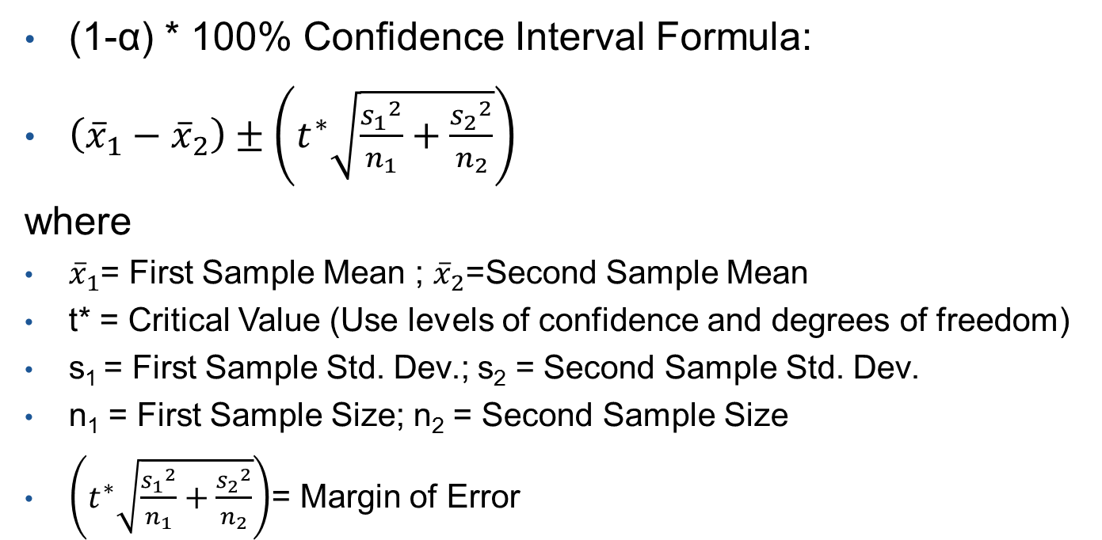
Confidence Interval (Independent Samples)
(1-α) * 100% Confidence Interval Formula:
$\left({\overline{x}}_{1}−{\overline{x}}_{2}\right)±\left(t^{∗}\sqrt{\frac{{s_{1}}^{2}}{n_{1}}+\frac{{s_{2}}^{2}}{n_{2}}}\right)$
where
${\overline{x}}_{1}$= First Sample Mean ; ${\overline{x}}_{2}$=Second Sample Mean
t* = Critical Value (Use levels of confidence and degrees of freedom)
s₁ = First Sample Std. Dev.; s₂ = Second Sample Std. Dev.
n₁ = First Sample Size; n₂ = Second Sample Size
$\left(t^{∗}\sqrt{\frac{{s_{1}}^{2}}{n_{1}}+\frac{{s_{2}}^{2}}{n_{2}}}\right)$= Margin of Error
Statistics Test

Slide 16
Confidence Interval – Independent Samples (Example)
Researchers led by Arlene Butz published a study on the reading practices of children . They wanted to know if there was a difference in the reading practices of children with developmental or behavioral problems (the DEV group or Group 1) compared to children in the general population who do not have developmental problems (the GEN group or Group 2.) One of the factors they considered was the number of nights each week that the children participated in reading in the home. Data representative of their results are given in the file ReadingPractices. Calculate and interpret a 95% Confidence Interval of the mean difference in the number of nights each week that the children participated in reading in the home between the two groups. (-0.149, 0.987)
We are 95% confident that the mean difference is between -0.149 and 0.987.
Zero is in the confidence interval so there is no difference between the means

Slide 17
Confidence Interval – Independent Samples (Example)
The FIFA Football (Soccer) World Cup is held every four years and is one of the biggest sporting events in the world. In 2006, Germany hosted the World Cup. A study was conducted by Dr. Wilbert-Lampen, et. al. to determine if the stress of viewing a soccer match would increase the risk of a heart attack or another cardiovascular event. We will use the data on cardiovascular problems during the World Cup to test the hypothesis that the mean number of cardiovascular events is greater during the World Cup than during the control period. Let Group 1 be days in the Control Period and let Group 2 represent days during the 2006 World Cup. Calculate and interpret a 99% Confidence Interval of the mean difference in the number of cardiovascular events between the two groups. (-7.771, -2.141)
We are 99% confident that the mean difference is between -7.771 and -2.141.
Zero is NOT in the confidence interval so there is appears to be a difference between the means

Slide 18
Inference for Two Means: Independent Samples
Intro to Independent Samples
Hypothesis Testing
Confidence Intervals
Checking Requirements

Slide 19
Requirements to Check and Descriptive Statistics
Before Doing Independent Samples Test
Requirements to Check for Independent Sample procedure
The samples are from Simple Random Sampling
The samples are independent
The distribution of sample means is normally distributed for each group. For each group check that either:
the data are normally distributed (Use Q-Q Plots) or
the sample size is large
Descriptive Statistics to Use with Data
Numerical – Sample Mean and Standard Deviation from both samples
Graphical – Histogram or boxplots from both groups

